Slide 1


Week 3
Blockchain Technology: XRPL and XLS-20 Standards
XRPL Technical Academy

Slide 2

Agenda
Introduction to Blockchain and Distributed Ledger Technology
Deep Dive into XRP Ledger (XRPL)
Exploring XLS-20 and Tokenization on XRPL
Security, Governance, and Compliance in XRPL
Development and Integration with XRPL
Case Studies, Future Developments, and Q&A
2

Slide 3

Session 1: Objectives
What You will Learn:
Understand the fundamentals of blockchain technology
Gain insights into Distributed Ledger Technology (DLT)
Explore the architecture and features of XRP Ledger (XRPL)
Learn about the XLS-20 tokenization standard
Discover the process of tokenization on XRPL
Understand the consensus mechanism and security practices
Learn how to set up and interact with XRPL clients
Explore real-world use cases and future developments
3

Slide 4
Introduction to Blockchain and Distributed Ledger Technology

Slide 5
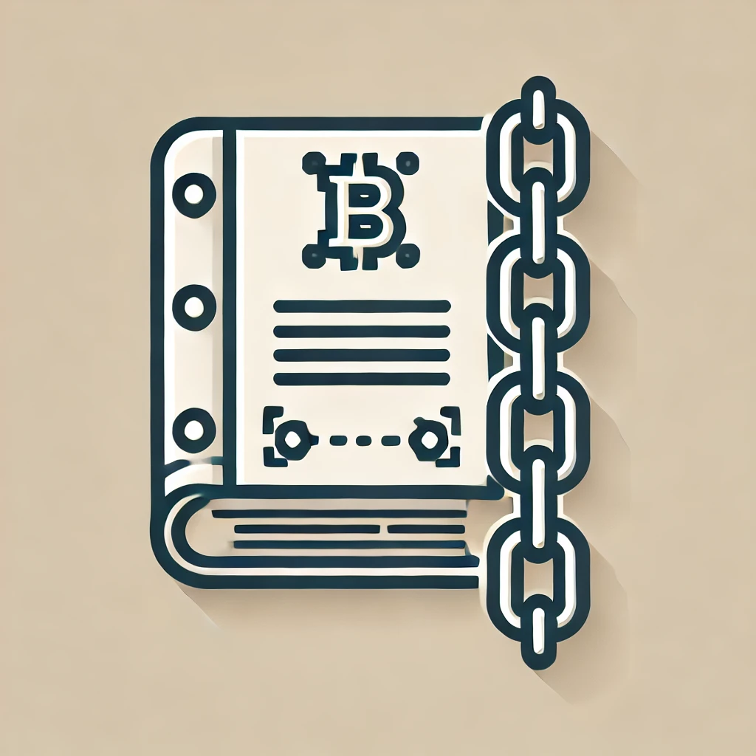
Introduction to Blockchain Technology
Understanding the Basics
Blockchain consists of decentralized ledgers.
Transactions are verified by network nodes.
All transactions are recorded chronologically.
Provides transparency and immutability of data.
Smart contracts automate business processes.
Consensus mechanisms ensure data integrity.
Public and private blockchain types exist.
It has applications in various industries.

Slide 6
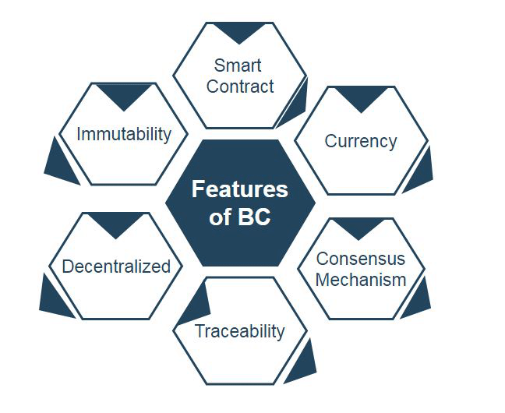
Overview of Distributed Ledger Technology (DLT)
Key Features and Concepts
DLT eliminates the need for a central authority.
It ensures data consistency across multiple nodes.
Transactions are recorded in a decentralized ledger.
Consensus algorithms validate and approve transactions.
DLT offers transparency and traceability of records.
It enhances security through cryptographic techniques.
Various DLT models include blockchain and directed acyclic graphs.
Applied in finance, supply chain, and healthcare sectors.

Slide 7
Deep Dive into XRP Ledger (XRPL)

Slide 8

Introduction to XRP Ledger (XRPL)
Core Principles and Features
XRPL is a decentralized, open-source blockchain.
It enables fast, low-cost international transactions.
Uses a unique consensus algorithm for validation.
Designed for scalability and high throughput.
Supports issuing and trading of digital assets.
Includes built-in decentralized exchange (DEX) functionality.
Energy-efficient compared to proof-of-work blockchains.
Provides advanced features like multi-signatures and escrow.

Slide 9
Key Features of XRPL
Exploring the Functionalities
Fast transaction processing with a 3-5 second settlement time.
Supports issuing custom digital currencies and assets.
Includes decentralized exchange (DEX) for trading assets.
Uses a consensus algorithm for validation, not mining.
Incorporates advanced features like multi-signature support.
Provides escrows and payment channels for controlled transactions.
Transparent and immutable transaction record with public visibility.
Cost-effective with minimal transaction fees, avoiding high costs.

Slide 10
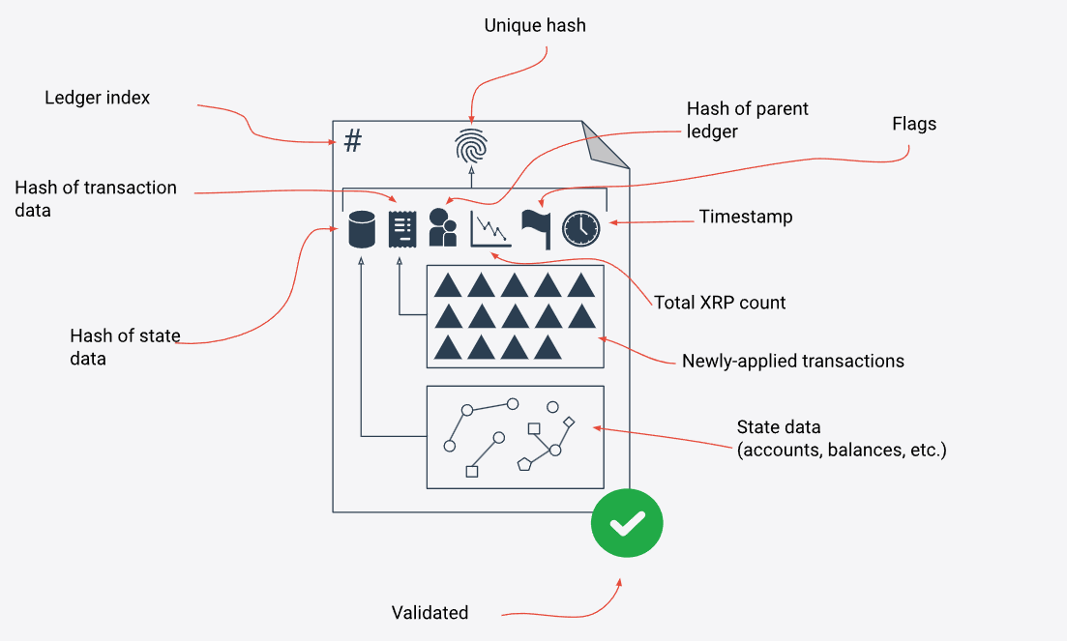
Consensus Mechanism in XRPL
Ensuring Validation and Security
XRPL uses Federated Byzantine Agreement (FBA) consensus algorithm
Validators reach agreement without mining or proof-of-work.
Consensus process requires 80% validator agreement.
It operates efficiently with low computational resources.
Higher decentralization increases network security and robustness.
Validators are chosen based on reliability and trustworthiness.
Network updates ledgers every few seconds with finality.
Ensures rapid, secure, and cost-effective transaction validation.

Slide 11
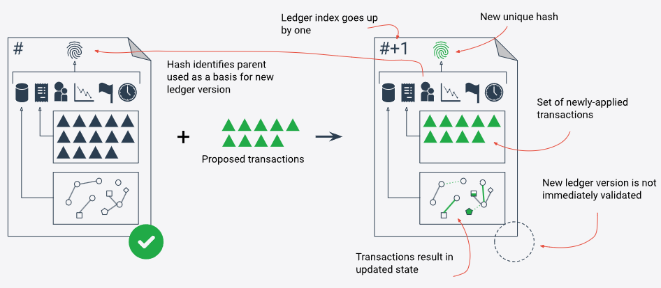
XRPL Architecture and Components
Understanding the Core Elements
Ledger: Stores all transactions and account information.
Nodes: Participate in network and validate transactions.
Validators: Special nodes validating ledger updates.
Client Applications: Interface for users to interact with XRPL.
Consensus Algorithm: FBA ensures transactions are validated.
Native Currency (XRP): Facilitates transactions and prevents spam.
APIs and SDKs: Allow developers to build on XRPL.
The XRP Ledger: Decentralized and publicly accessible blockchain.

Slide 12
Exploring XLS-20 and Tokenization on XRPL

Slide 13
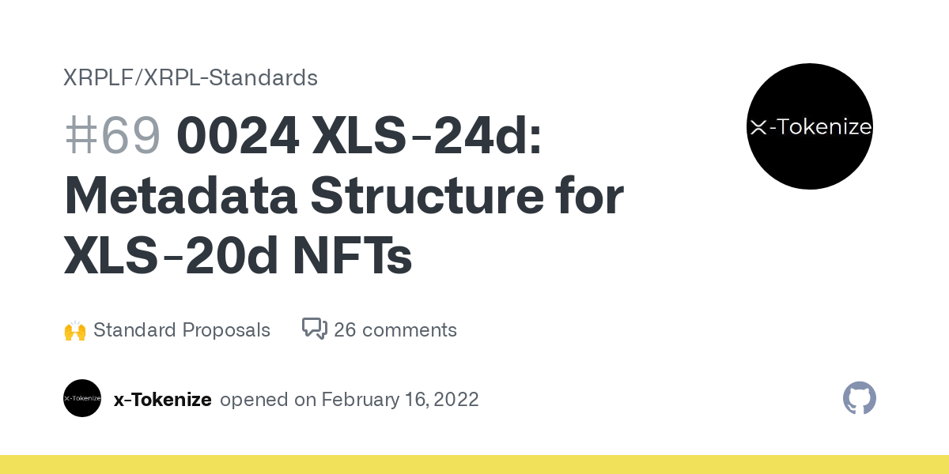
Introduction to XLS-20
Tokenization Standard on XRPL
XLS-20 is XRPL’s native tokenization standard.
Enables creating and managing non-fungible tokens (NFTs).
Streamlines token issuance with built-in XRPL features.
Supports efficient, low-cost NFT transactions.
Provides native decentralized trading mechanisms.
Includes metadata support for detailed token information.
Ensures token interoperability within the XRPL ecosystem.
Designed for high scalability and broad application use cases.

Slide 14
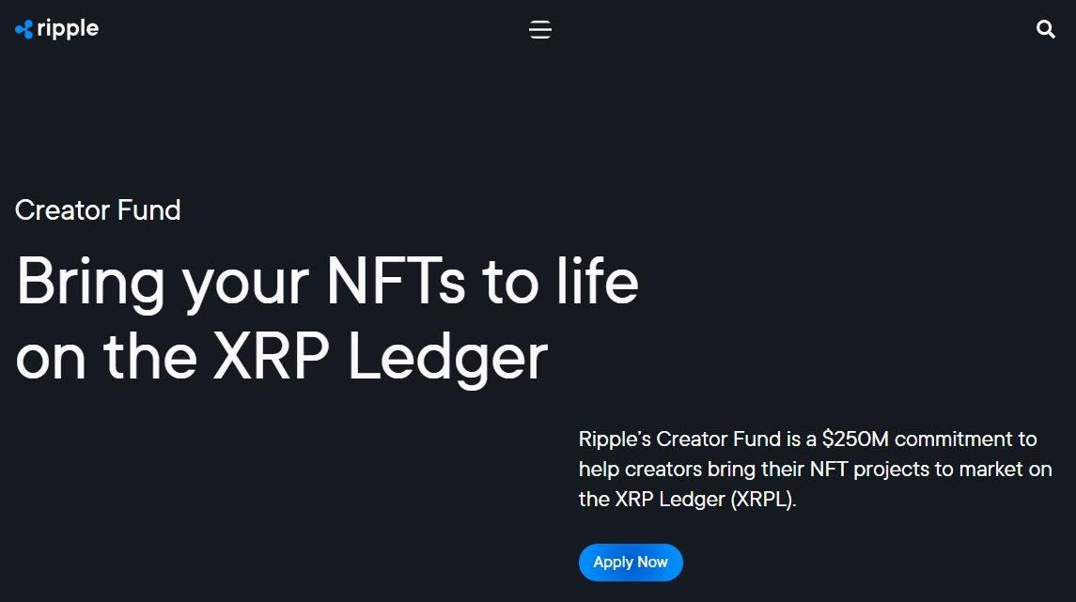
Key Features of XLS-20
Exploring the Capabilities
Native support for non-fungible tokens (NFTs) on XRPL.
Enables direct issuance and management of NFTs.
Utilizes XRPL’s consensus mechanism for validation.
Low transaction fees for cost-effective NFT operations.
Built-in decentralized exchange (DEX) for NFT trading.
Metadata support provides detailed information for NFTs.
Enhanced security through XRPL's robust framework.
High scalability for handling large volumes of NFTs.

Slide 15
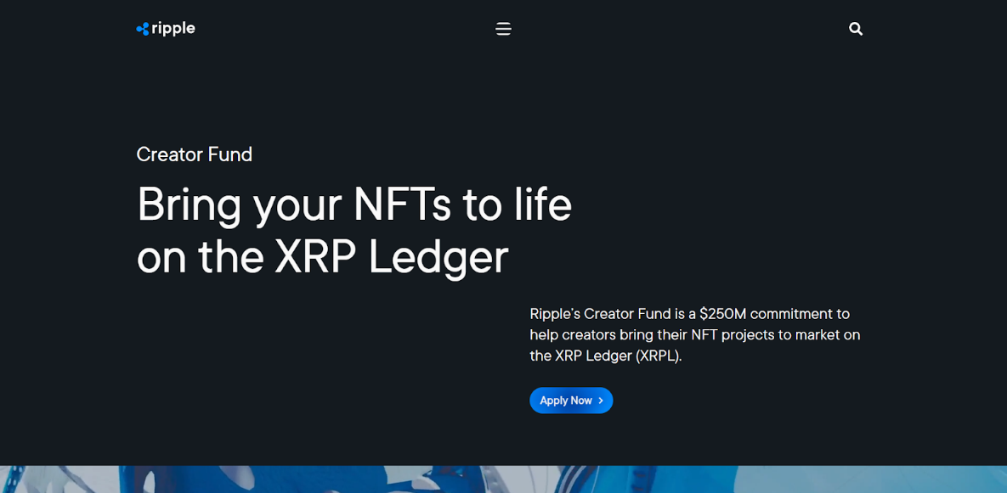
Tokenization on XRPL with XLS-20
Process and Benefits
Easy issuance of NFTs directly on the XRPL.
Automated token management with XRPL’s built-in functionalities.
Low transaction costs provide economic advantage.
Secure token transfers using XRPL’s validation mechanisms.
Comprehensive metadata support for flexible token designs.
Interoperability with other XRPL-native features and protocols.
Efficient trading on XRPL’s decentralized exchange platform.
Scales to handle large numbers of NFTs seamlessly.

Slide 16
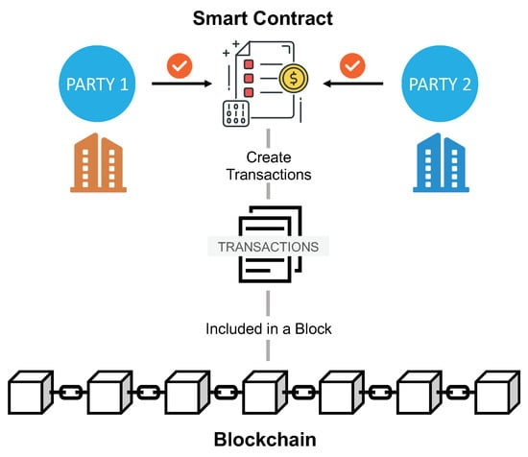
Smart Contracts on XRPL
Functionality and Advantages
Enable automated execution of predetermined contract conditions.
Utilized through XRPL’s versatile scripting capabilities.
Allow trustless transactions without central intermediaries.
Ensure accurate and reliable contract execution.
Reduce costs associated with traditional contract management.
Enhance security by minimizing human intervention.
Integrate seamlessly with XRPL’s existing ecosystem.
Facilitate complex financial agreements and asset management.

Slide 17
Security, Governance, and Compliance in XRPL

Slide 18

Security and Privacy on XRPL
Measures and Best Practices
Ensure secure storage of private keys and seed phrases.
Use multi-signatures for enhanced transaction security.
Regularly update software to patch vulnerabilities.
Monitor account activity for suspicious transactions.
Implement strong, unique passwords for account access.
Utilize hardware wallets for offline key storage.
Avoid sharing sensitive information over unsecured channels.
Conduct regular security audits and risk assessments.
Source Here

Slide 19
Governance and Compliance in XRPL
Structure and Best Practices
Decentralized governance through consensus and validator voting.
Validators play a crucial role in network decisions.
Ensure compliance with global regulatory standards.
Implement KYC/AML for anti-money laundering measures.
Regularly review and update governance policies.
Transparent transaction records aid regulatory compliance.
Community proposals guide protocol improvements.
Engage with regulatory bodies for staying compliant.

Slide 20
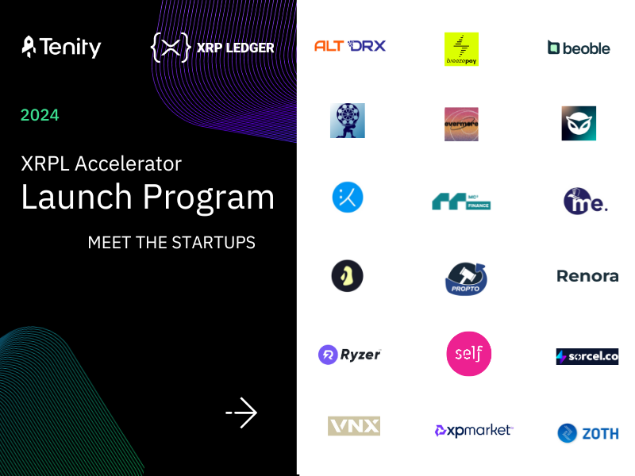
Case Studies: Real-World Applications of XRPL
Success Stories and Implementations
Santander uses XRPL for international payment solutions.
Coil utilizes XRPL for micro-payments in content platforms.
XRP Tip Bot facilitates peer-to-peer tipping on social media.
Forte leverages XRPL for in-game asset tokenization.
SBI Holdings adopts XRPL for remittance services in Asia.
Sologenic issues tokenized securities on XRPL.
XRPL Labs develops financial applications like Xumm wallet.
XRPL used in smart supply chain solutions by multiple firms.

Slide 21
Development and Integration with XRPL

Slide 22

Use Cases of XRPL and XLS-20
Real-World Applications
Cross-border payments with low fees and high speed.
Issuing and trading digital assets, including NFTs.
Decentralized finance (DeFi) applications and services.
Supply chain management through transparent ledger tracking.
Tokenized real estate for fractional ownership.
Gaming industry for in-game asset tokenization.
Identity verification and secure data sharing.
Micropayments and streaming transactions for digital content.

Slide 23
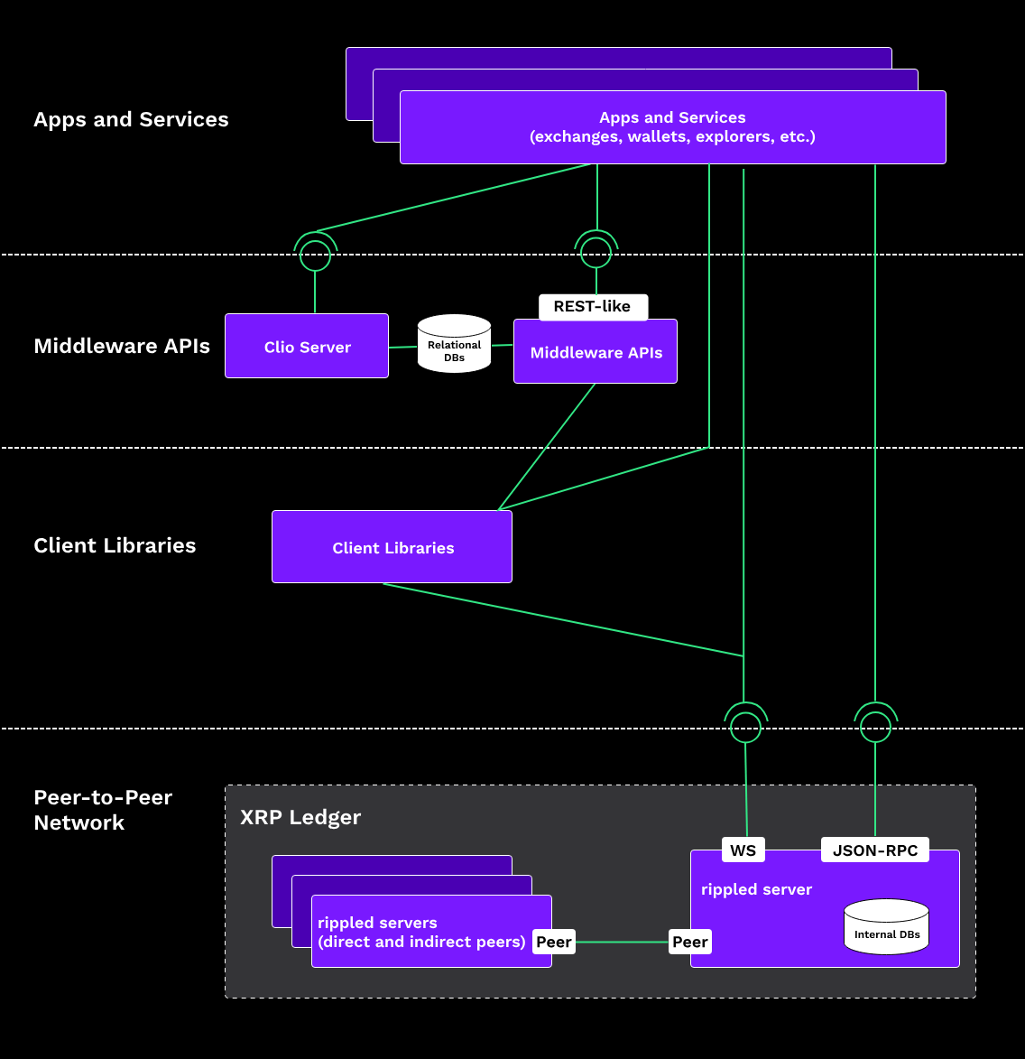
Setting Up an XRPL Client
Steps and Requirements
Install XRPL client software on your computer.
Create a new wallet with unique private key.
Securely store your wallet’s private key.
Connect to an XRPL node for network access.
Fund your wallet with XRP for transactions.
Familiarize yourself with client interface and features.
Use API calls to interact with XRPL network.
Test transactions on the XRPL Testnet first.

Slide 24
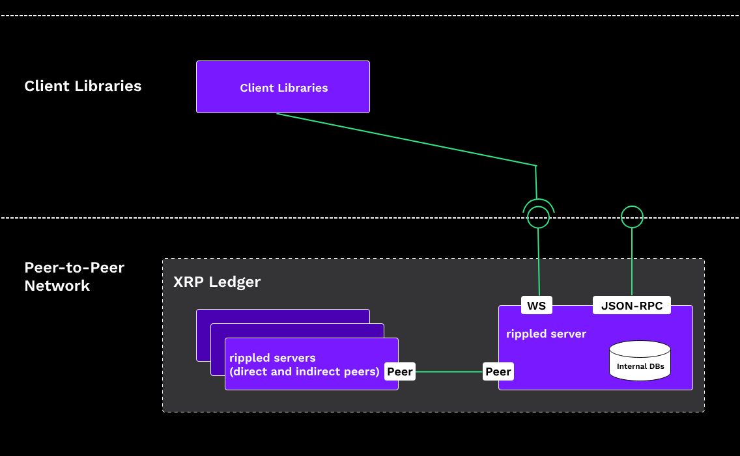
Interacting with XRPL: Tools and APIs
Essential Resources and Methods
XRP Ledger Explorer for viewing transaction details.
Use RippleAPI for JavaScript to interact with XRPL.
Utilize rippled server for direct node communication.
Access XRPL SDKs for various programming languages.
Leverage Multi-signature service for enhanced security.
Explore Testnet and Devnet for safe testing environments.
Secure transactions using WalletPro library features.
Regularly check XRPL documentation for updates.

Slide 25
Creating and Managing XRPL Accounts
Steps and Best Practices
Generate a new XRPL account using wallet software.
Securely store your seed phrase and private key.
Fund the account with a minimum of 20 XRP reserve.
Enable and configure necessary account settings.
Set up multi-signature for added account security.
Regularly monitor account balance and transaction history.
Use XRPL APIs for automated account management tasks.
Regularly back up account credentials and data.

Slide 26
Issuing and Managing Tokens on XRPL
Steps and Key Considerations
Create and fund an XRPL issuing account.
Set the necessary configurations for token issuance.
Issue tokens using XRPL's payment and trustline features.
Distribute tokens to recipient accounts securely.
Manage token supply through XRPL's APIs.
Utilize XRPL’s DEX for trading and liquidity.
Implement trustline limits for risk management.
Monitor token transactions and adjust strategies accordingly.

Slide 27
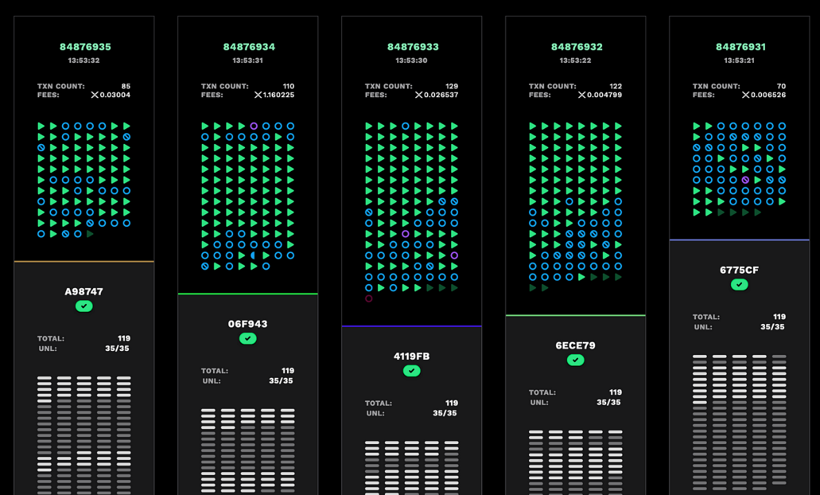
Understanding XRPL Transactions
Types and Processes
Payment transactions for sending XRP between accounts
Trustline transactions to extend credit lines.
Offer create and cancel for managing DEX orders.
Escrow create and finish for conditional payments.
Check create, cash, and cancel for payment checks.
AccountSet to modify account settings and flags.
DepositPreauth for pre-authorizing incoming transactions.
SignerListSet to configure multi-signature accounts.
https://xrpscan.com/

Slide 28
Performance and Scalability of XRPL
Capabilities and Enhancements
High throughput with over 1,500 transactions per second.
Efficient consensus algorithm ensures fast transaction finality.
Low transaction fees support cost-effective operations.
Scalability to handle large volumes of transactions.
Minimal energy consumption compared to proof-of-work systems.
Ongoing improvements to enhance network performance.
Robust infrastructure to minimize downtime and outages.
Future upgrades for long-term scalability and efficiency.

Slide 29
Developing Decentralized Applications (DApps) on XRPL
Steps and Best Practices
Understand XRPL architecture and core concepts.
Set up a development environment using XRPL tools.
Utilize XRPL APIs and SDKs for application integration.
Create secure, scalable smart contracts for DApps.
Implement user authentication using XRPL accounts.
Test DApps on XRPL Testnet before mainnet deployment.
Monitor and optimize DApp performance continuously.
Ensure compliance with relevant regulations and standards.

Slide 30
Best Practices for XRPL Development
Guidelines for Effective Implementation
Use secure libraries and frameworks for development.
Regularly review and update your codebase.
Test thoroughly on XRPL Testnet before mainnet deployment.
Implement multi-signatures for critical transactions.
Document your code for better collaboration.
Monitor network updates and incorporate them promptly.
Engage with the XRPL community for support.
Prioritize scalability and security in your design.

Slide 31
Hands-On Workshop: Building on XRPL
Practical Steps and Exercises
Set up your development environment with XRPL tools.
Create a new XRPL account and secure your keys.
Fund your account using Testnet XRP.
Issue a custom token and configure trustlines.
Create and submit a simple payment transaction.
Set up a basic smart contract using XRPL scripts.
Monitor and manage transactions through the XRP Ledger Explorer.
Test and debug your code with community support.

Slide 32
Case Studies, Future Developments, and Q&A

Slide 33
Case Studies: Real-World Applications of XRPL
Success Stories and Implementations
Santander uses XRPL for international payment solutions.
Coil utilizes XRPL for micro-payments in content platforms.
XRP Tip Bot facilitates peer-to-peer tipping on social media.
Forte leverages XRPL for in-game asset tokenization.
SBI Holdings adopts XRPL for remittance services in Asia.
Sologenic issues tokenized securities on XRPL.
XRPL Labs develops financial applications like Xumm wallet.
XRPL used in smart supply chain solutions by multiple firms.

Slide 34
Future Developments in XRPL and XLS-20
Innovations and Prospects
Enhanced cross-border payment solutions for global transactions.
Improved scalability with sharding and parallel processing.
Advanced smart contract capabilities for complex agreements.
Integration of DeFi applications within the XRPL ecosystem.
Broader adoption of NFTs through XLS-20 standards.
Increased interoperability with other blockchain networks.
Enhanced privacy features for confidential transactions.
Continuous updates to maintain regulatory compliance.

Slide 35
Challenges and Limitations of XRPL
Areas for Improvement
Scalability issues when handling a high volume of transactions.
Regulatory uncertainties affecting global adoption.
Limited smart contract functionality compared to other blockchains.
Centralization concerns due to validator distribution.
Competition with other established payment protocols.
Security risks from potential network vulnerabilities.
Difficulty in achieving network-wide consensus.
Limited user awareness and adoption challenges.

Slide 36
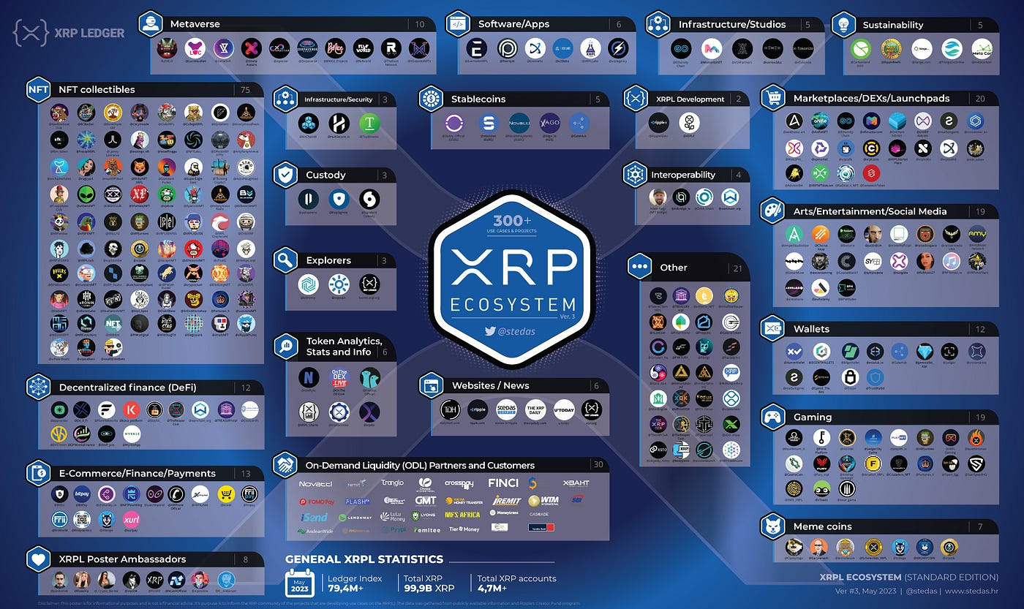
XRPL Community and Ecosystem
Collaboration and Growth
Active developer forums for sharing knowledge and resources.
Community-driven initiatives for network improvements.
Grants and funding opportunities for innovative projects.
Regular meetups, webinars, and conferences worldwide.
Open-source contributions enhancing XRPL capabilities.
Collaboration with academic and research institutions.
Strategic partnerships with industry leaders and startups.
Online resources, including documentation and tutorials.

Slide 37
Resources for Further Learning
Enhance Your XRPL Knowledge
Visit the official XRPL documentation for in-depth guides.
Explore Ripple’s developer portal for tools and resources.
Join the XRPL community forum for discussions and support.
Watch educational videos on XRPL’s YouTube channel.
Participate in online courses and webinars on blockchain.
Read research papers and articles on XRPL advancements.
Follow XRPL developers and experts on social media.
Experiment with XRPL Testnet for hands-on practice.

Slide 38
Conclusion and Q&A
Recap and Discussion
Summarized blockchain, XRPL, and XLS-20 fundamentals.
Explored key features and use cases of XRPL.
Discussed consensus mechanisms and security practices.
Reviewed tokenization and smart contract capabilities.
Highlighted development tools and best practices.
Addressed regulatory and compliance considerations.
Provided resources for continued learning and development.
Open floor for questions and interactive discussion.

Slide 39
References

Slide 40

References
Ripple Documentation
URL: https://xrpl.org/documentation.html
XRP Ledger Dev Portal
URL: https://xrpl.org/
Ripple Whitepaper
URL: https://ripple.com/files/ripple_consensus_whitepaper.pdf
XLS-20d Proposal
URL: https://github.com/XRPLF/XRPL-Standards/discussions/16
Ripple Insights Blog
URL: https://ripple.com/insights/
Coil Blog
URL: https://coil.com/blog/
XRPL Labs Blog
URL: https://xrpl-labs.com/blog/
Ripple's Developer Portal
URL: https://developers.ripple.com/
Sologenic Whitepaper
URL: https://www.sologenic.com/whitepaper
Forte Platform Overview
URL: https://www.forte.io/
7

Slide 41
Questions?
Contact Us:
christodoulou.kl@unic.ac.cy
touloupos.m@unic.ac.cy

